Slide 1
Contact Manager
A Group 5 Presentation

Slide 2
Team Members
Joel Gonzalez
Lauren Hastings
Vanessa Garcia De Quevedo
Zachary Shea
Brandyn Brinston
Brandon Haynes

Slide 3
Requirements
Create a personal contact manager with login
Each user should be able to add, delete, and search their own contacts
The user interface should be clean and professional
The project should be professional

Slide 4
Solution
Created the contact manager as a web application
To access the contact manager, users will use their given username and password. Once logged in, they can add, delete and search for contacts.
By making it as a web application, users can access their contact list from anywhere.

Slide 5


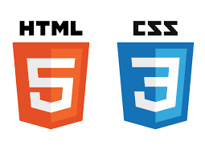


Technologies
Database: MySQL
Backend: Node.js
Client: JavaScript
UI: HTML & CSS
Code on GitHub
Hosted with AWS

Slide 6
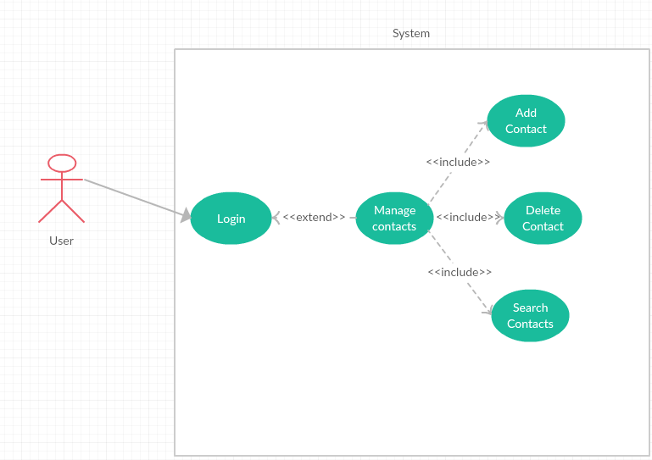
Use-Case Diagram

Slide 7
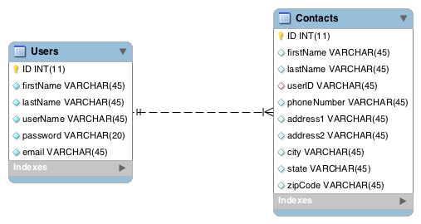
Database ERD

Slide 8
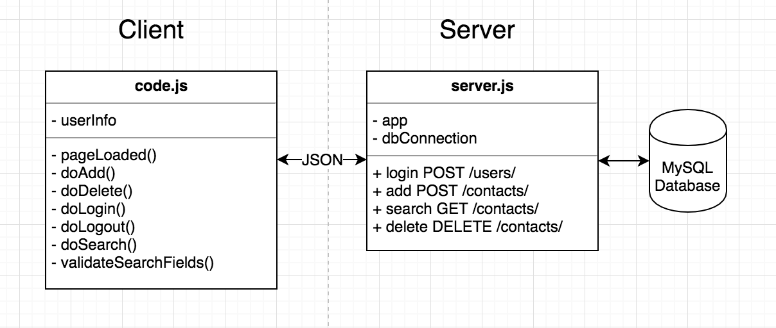
Client & Server UML

Slide 9
Difficulties
Learning Curve
Hosting configuration
Deadlines
How information is presented to user

Slide 10
Successes
Communication
Learned new languages/tools
Requirements met

Slide 11

Questions?

